Slide 1

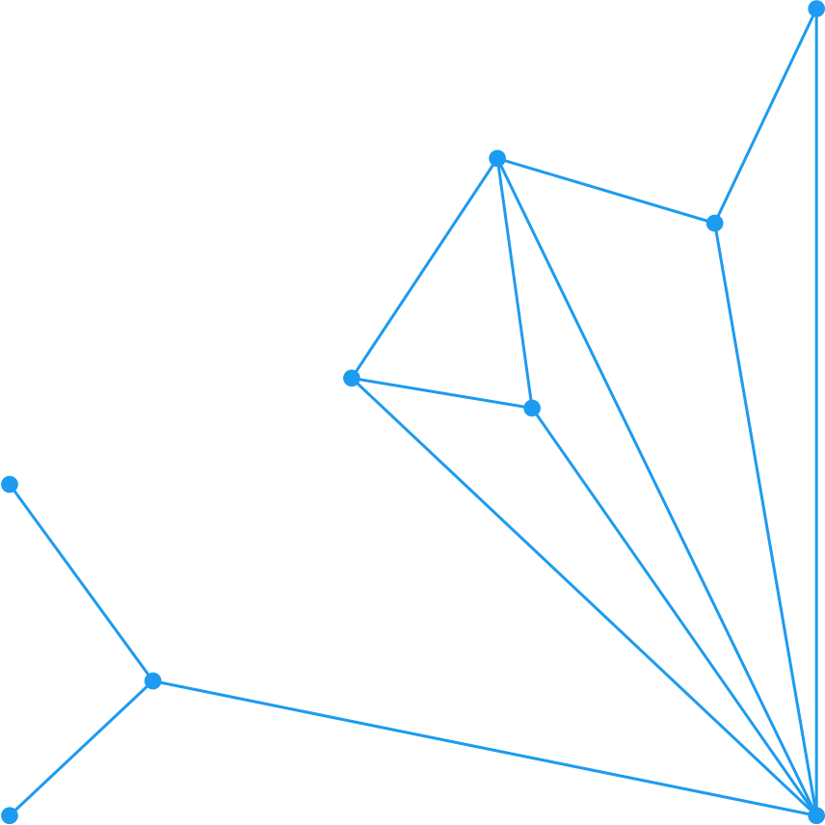




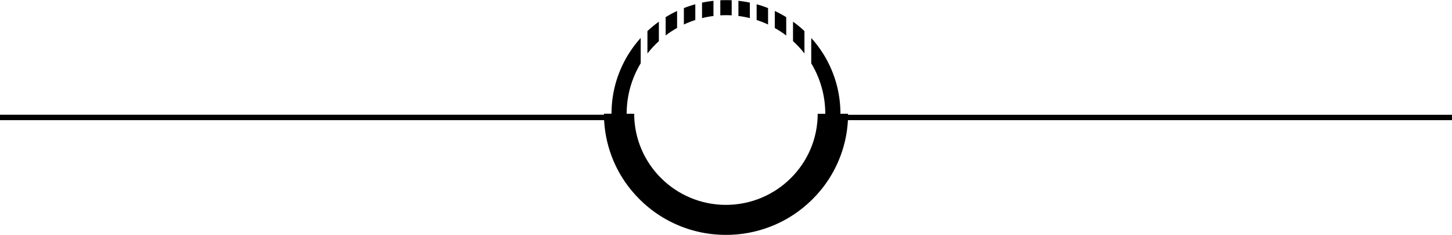
FUNDAMENTALS OF EPIDEMIOLOGY: Definitions, Principles & Measures of Disease
GEORGE OMONDI PAUL
SENIOR RESEARCH FELLOW
CENTER FOR EPIDEMIOLOGICAL MODELLING AND ANALYSIS
1

Slide 2
Epidemiological Thinking – Motivating Example
Understanding Disease in Populations
Key Measures in Action
Prevalence: 247 million malaria cases globally in 2021.
Incidence: ~619,000 deaths annually; highest rates in Sub-Saharan Africa.
Risk Ratio: Children <5 years are 4x more likely to die from malaria than adults.
Odds Ratio: Bed net use reduces malaria odds by 50-70%.
Population Perspective
Individual focus: "Does this person have malaria?“
Epidemiological focus: "Why do certain populations have higher malaria burden? What patterns emerge across time, place, and person?"
2

Slide 3
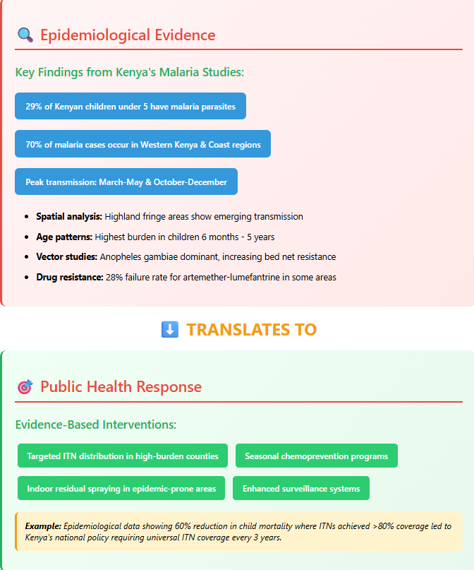
Foundational Definitions
Epidemiology: The study of disease distribution and determinants in populations to control health problems.
Public Health: Organized community efforts to prevent disease, promote health, and prolong life.
Relationship: Epidemiology provides the scientific foundation for public health action
3

Slide 4
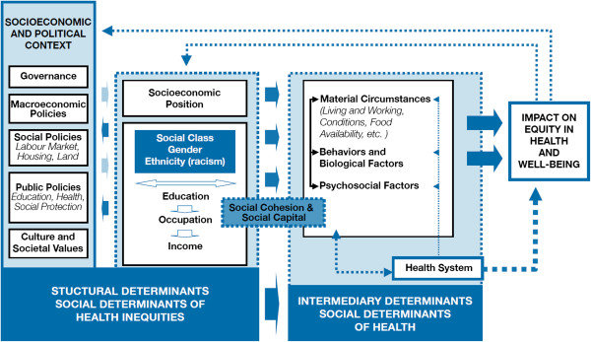
Social Determinants of Health
Social determinants of health refer to the circumstances in which individuals are born, grow, live, work, and age. These interact with social, political and economic factors to influence health and health outcomes (CSDH, 2008).
4

Slide 5
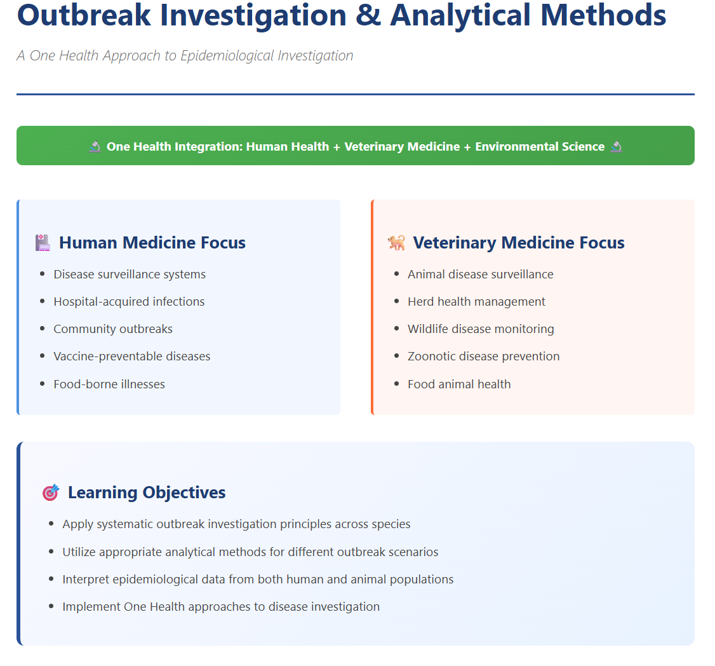
5

Slide 6
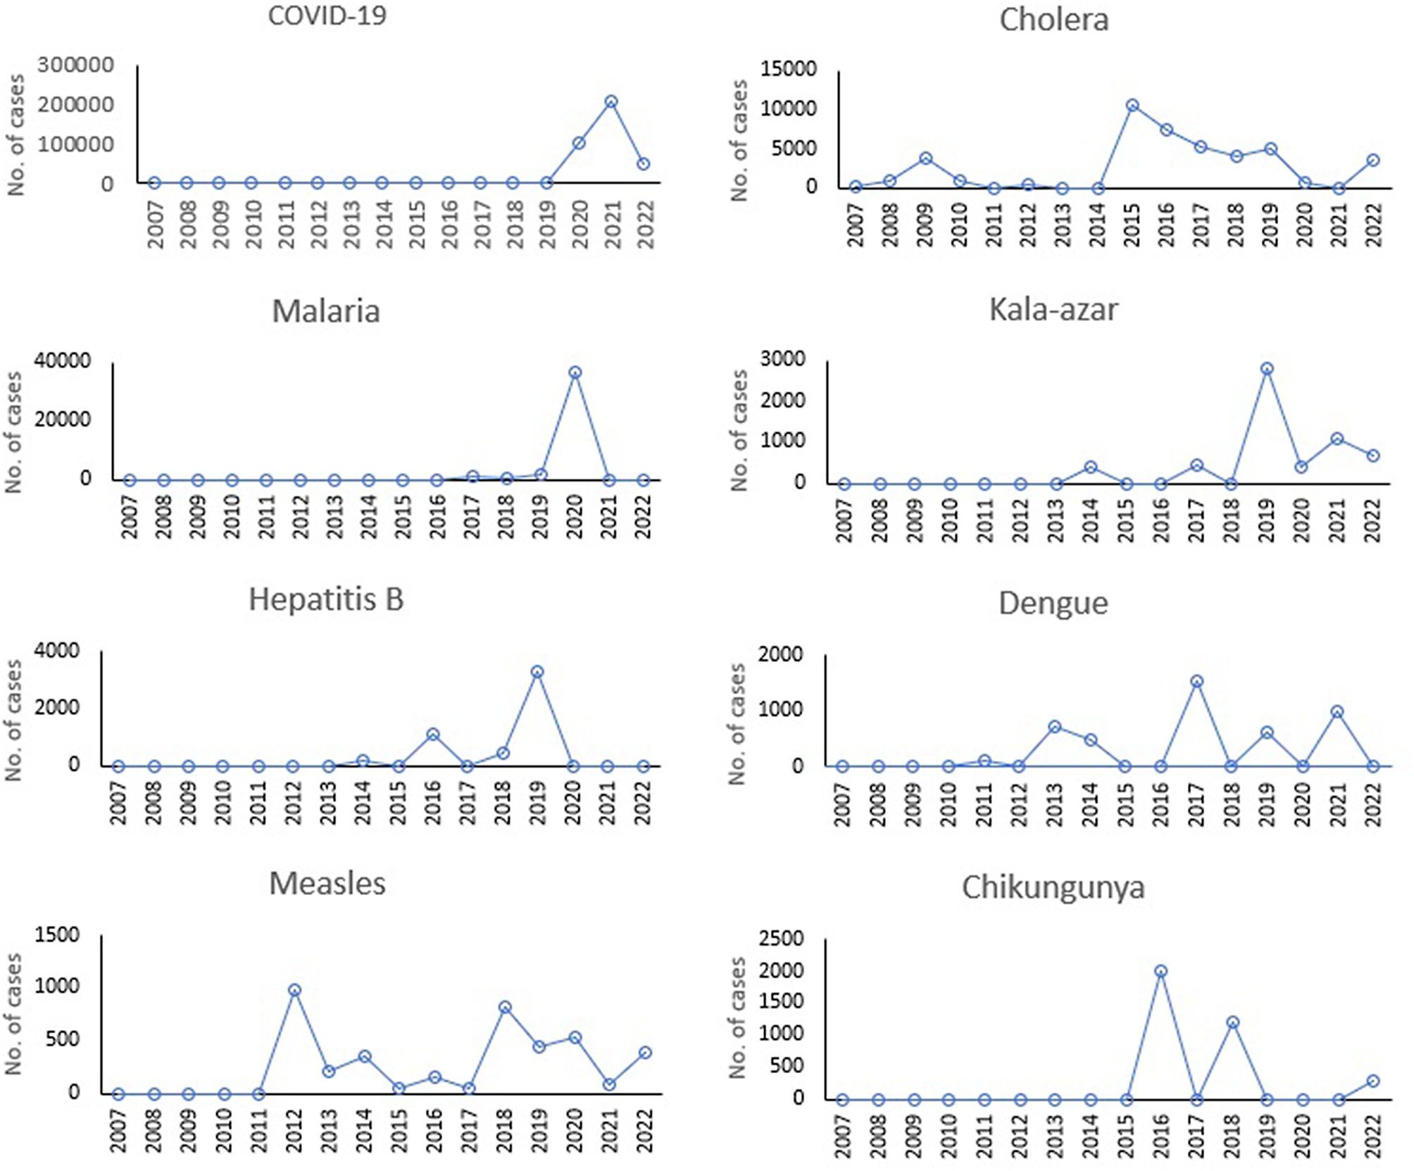
Epidemiological Thinking – Outbreak Investigation
Understanding Disease in Populations
Unexpected increase in disease cases in a specific population, time, or place (human or animal).
Purpose: Identify source, control spread, and prevent future outbreaks.
Key Steps (Brief Overview):
Prepare and confirm the outbreak (e.g., anthrax in cattle, COVID-19 in humans).
Define cases and collect data (clinical signs in animals, symptoms in humans).
Implement control measures (quarantine, vaccination).
6

Slide 7
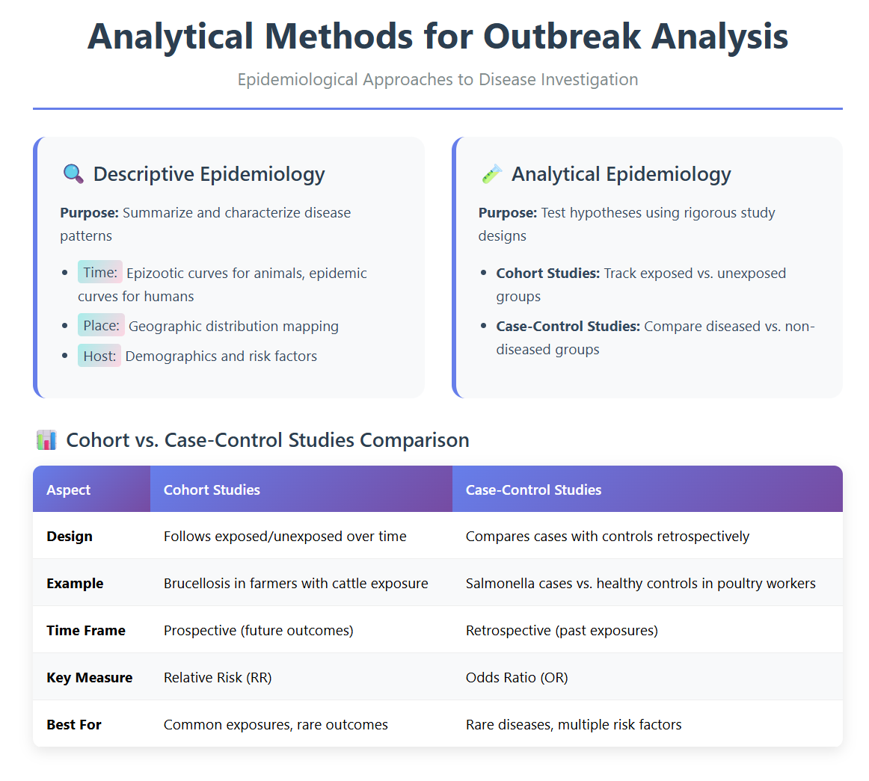
Epidemiological Thinking
7

Slide 8
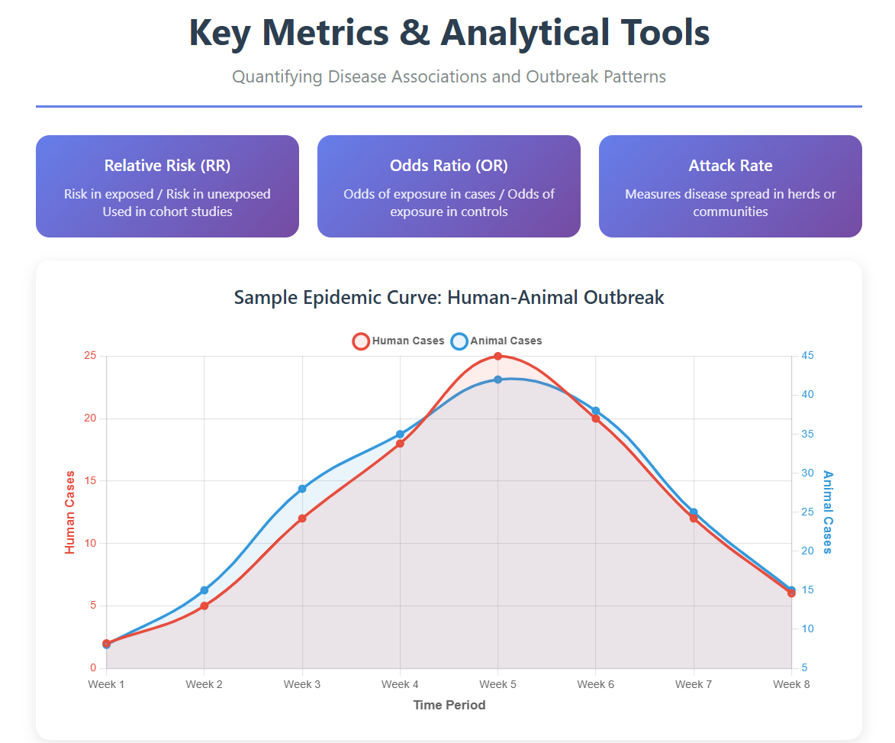
Epidemiological Thinking
8

Slide 9
Epidemiological Thinking – Uses and Approaches
Uses of Epidemiology
There are five objectives of epidemiology
Determination of the origin of a disease whose cause is known
The critical questions to ask are ‘why has an outbreak occurred? Or why has the number of cases increased?
Investigation and control of a disease whose cause is either unknown or poorly understood
Diseases can be controlled based on epidemiological observations before a cause is known
E.g. Snow’s control of cholera before the Vibrio cholera was isolated
9

Slide 10
Epidemiological Thinking – Uses and Approaches
Uses of Epidemiology
3. Acquisition of information on the ecology and natural history of disease
Host: An animal that can become infected with an infectious agent
Hosts and agents exist in communities that include other organisms, all of which live in specific environments/niches.
The aggregate of all facts relating to animals and plants is their natural history
Related communities and their environments are termed ecosystems
The study of ecosystems is ecology.
A comprehensive understanding of the natural history of infectious agents is possible only when they are studied in the context of their host’s ecosystems (Medical ecology)
E.g, helminth parasites during warm and humid seasons, fascioliasis in poorly drained areas, vector-borne diseases in wet seasons.
10

Slide 11
Epidemiological Thinking – Uses and Approaches
Uses of Epidemiology
4) Planning, monitoring, and assessment of disease control programs
Institution of a program to control/eradicate disease in a population must be based on a knowledge of the amount of disease (Prevalence), factors associated with its occurrence (risk factors), facilities required to control the disease (infrastructure), and the costs and benefits involved.
Epidemiological techniques employed include the routine collection of data on disease in the population (Monitoring and Surveillance) to decide if the various strategies are being successful.
5) Assessing the economic effects of a disease and of its control
Cost of control of disease must be balanced against the economic loss attributable to the disease
Economic analysis (cost/benefit analysis) is an essential part of modern planned animal health programs.
11

Slide 12
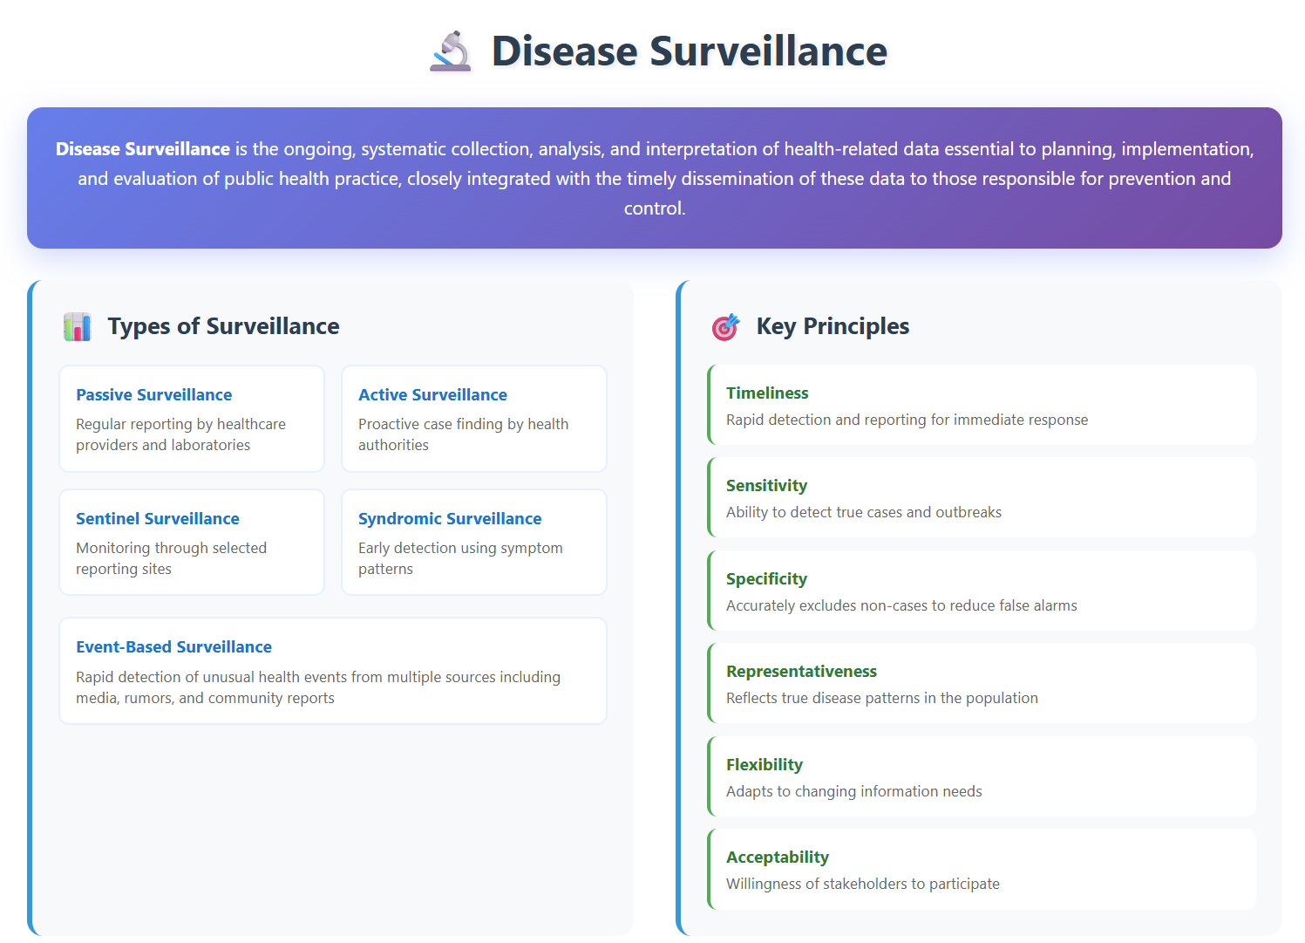
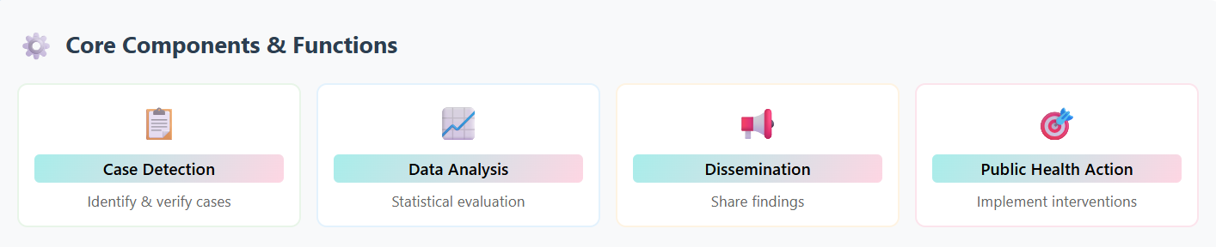
12

Slide 13
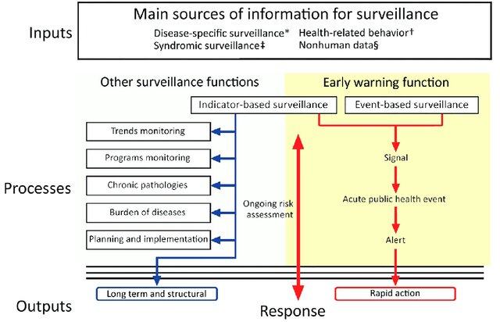
13

Slide 14
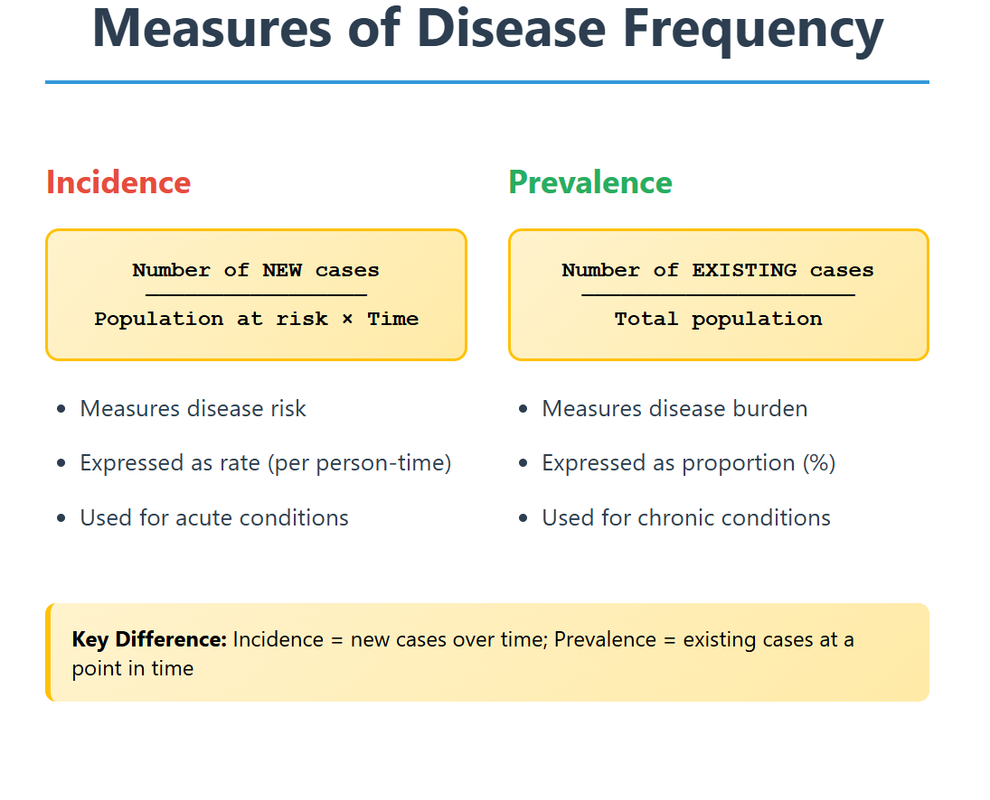
Measures of Association
14

Slide 15
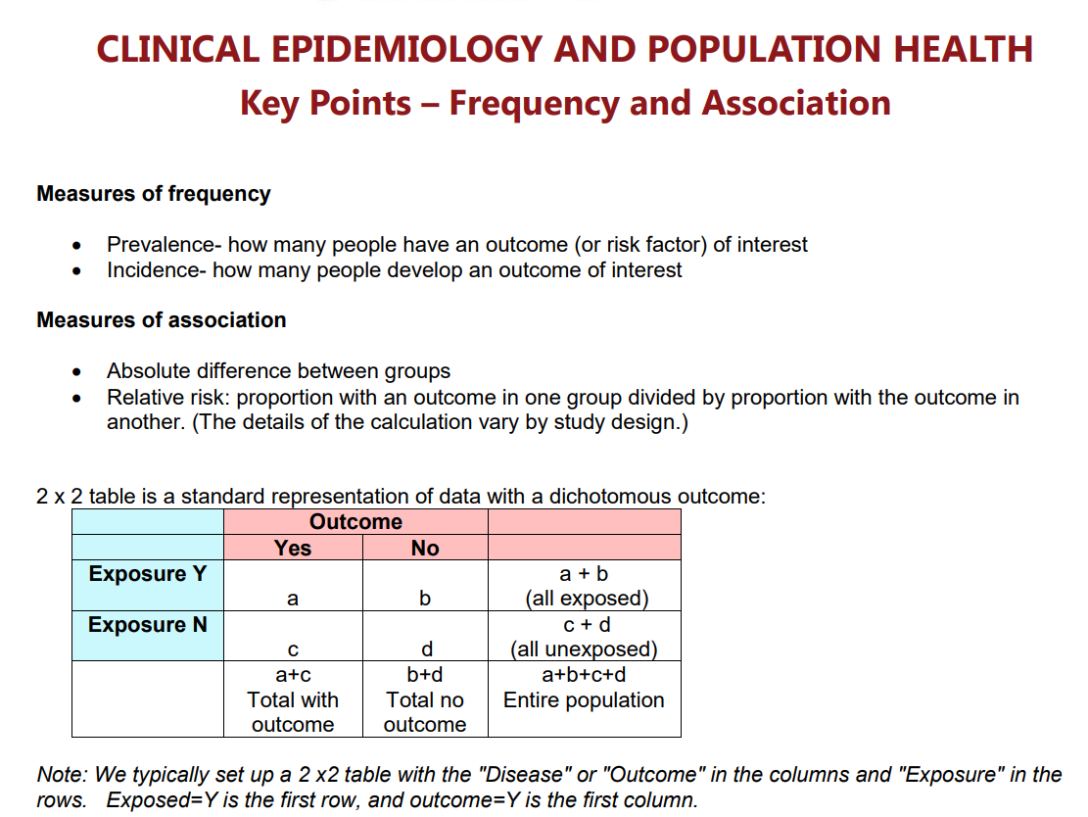
Measures of Association
15

Slide 16
After establishing statistical significance, epidemiologists apply other measures of association that are independent of sample size:
Strength of the association
Effect of factor in exposed group
Effect of factor in the population
1) Strength of the association: A measure of the strength of association between exposure factor (F) and disease (D) is the relative risk (relative ratio, RR).
- RR = Rate of D in F+/Rate of disease in F-.= [a/(a+b)/c/(c+d)]
= p(D+/F+ Vs p(D+/F-).
16

Slide 17
-Can only be calculated for cohort and cross-sectional studies, but not for case-control studies, because the frequency of disease (p(D+)) is an arbitrary value determined by the number of cases and controls included in the study
RR < 1, exposure is protective (e.g, vaccines; RR = 1, exposure has no effect; RR> 1, exposure is positively associated with disease).
- For a case-control study, use the odds ratio (OR) as an estimate of RR.
-If D in the population is of low prevalence (<5%) the OR is very close in magnitude to what RR would be if it could be calculated
-In such cases, a is relatively small and approximates a+b, thus a/a+b ~ a/b; also, c/c+d ~ c/d.
-RR (a/b)/(c/d) = ad/bc = OR
17

Slide 18
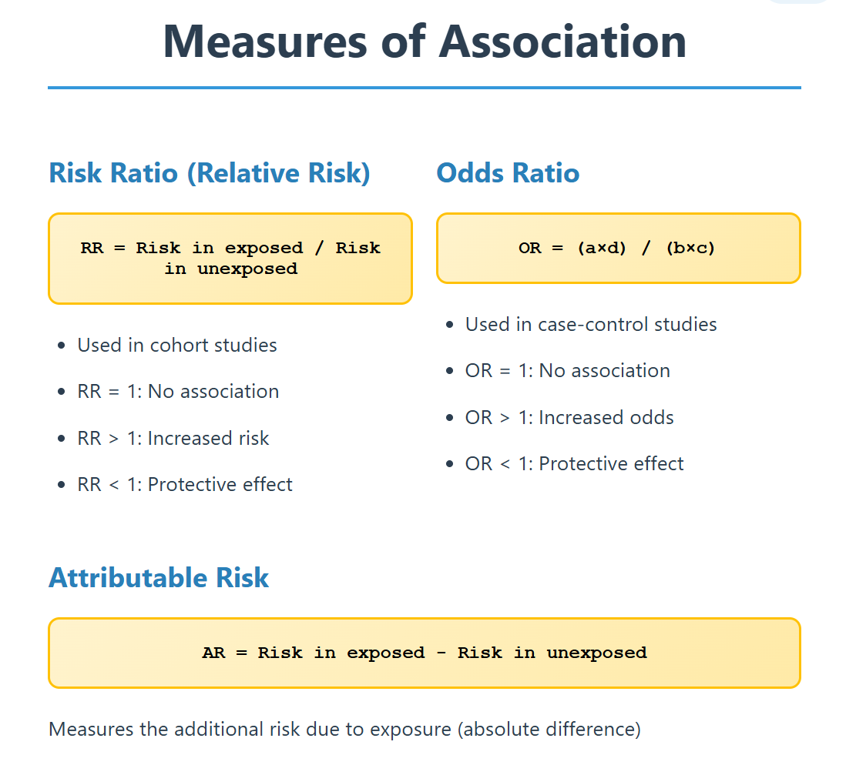
18

Slide 19
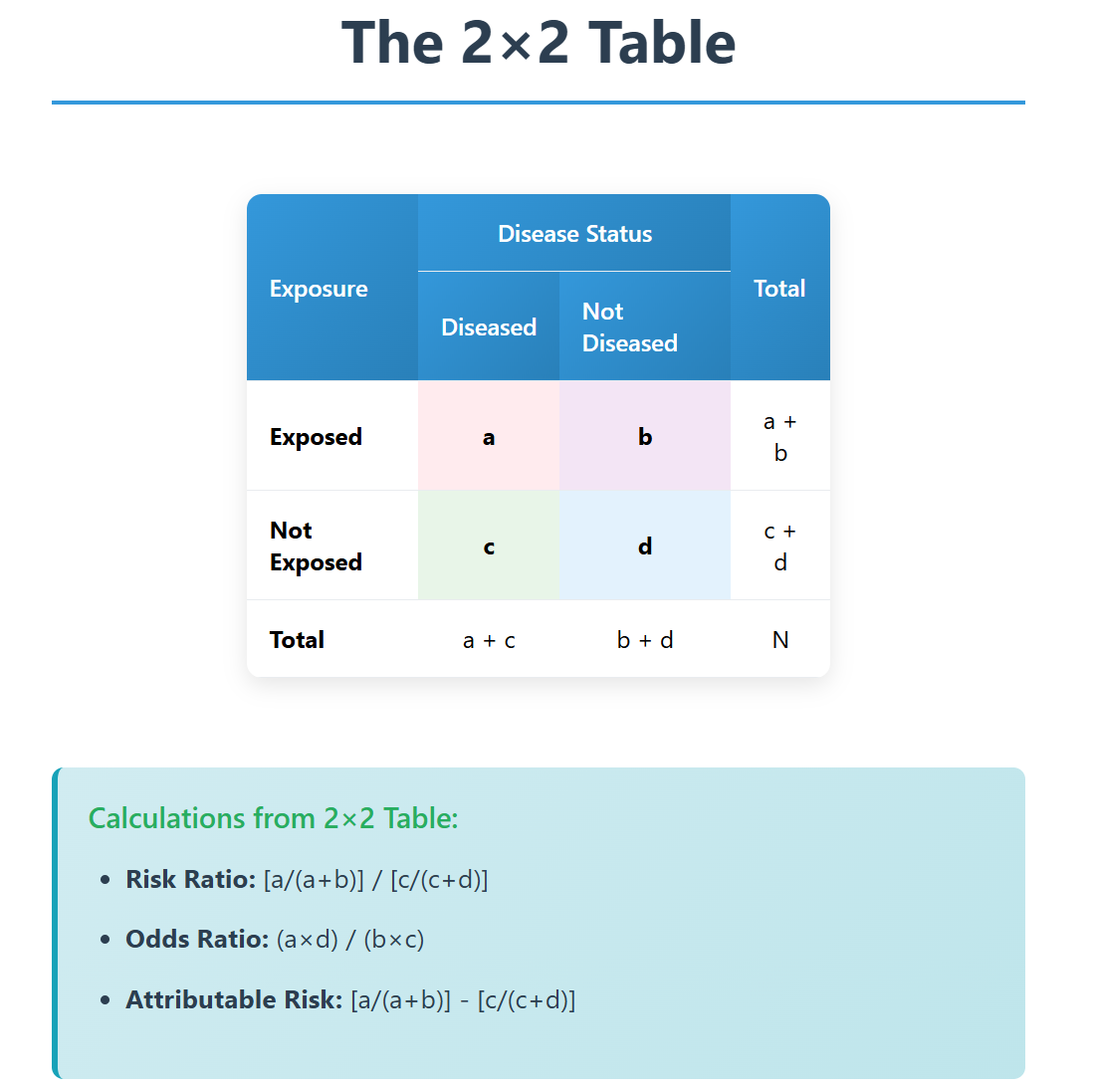
19

Slide 20
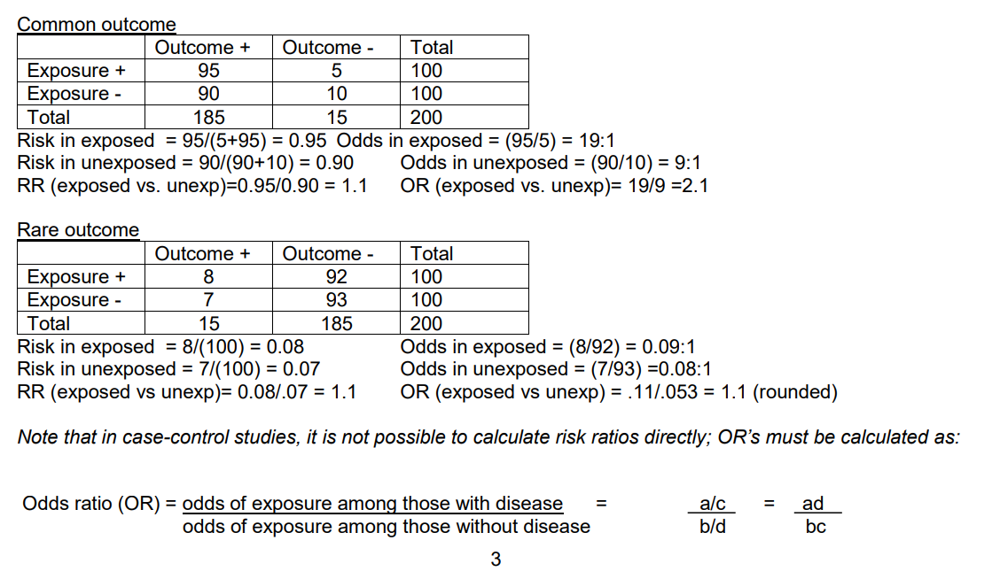
20

Slide 21
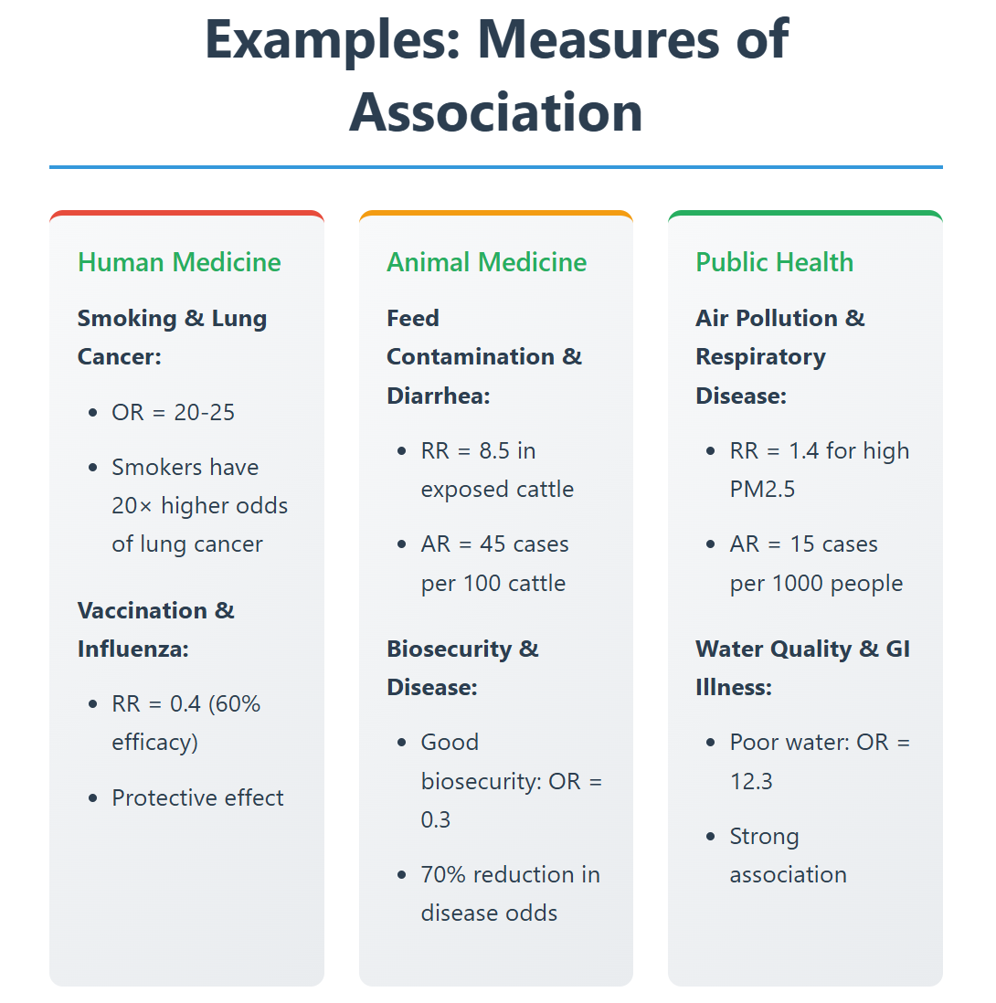
21

Slide 22
-OR has the same interpretation as RR and can be used in all sampling methods, but will always overestimate RR
2) Effect of F in the exposed group
There’s usually some disease in the F- group, and thus not all of the D in the exposed is due to the factor.
The difference between the two rates is explainable or attributable to the factor
This absolute difference is called the attributable risk (AR)
AR = [a/(a+b)] – [c/(c+d)]; p(D+/F+-p(D+/F-); This is the rate of disease in the F+ gp which is due to having the F.
It indicates the increase in the probability of disease in an exposed group, beyond the baseline risk, that results from the exposure.
22

Slide 23
Attributable Fraction(exposed): The AF_{e} expresses the proportion of disease in exposed individuals that is due to the exposure, assuming the relationship is causal. AF_{e} = AR/[a/(a+b)] = (RR – 1)/RR.
3) Effect of F in the population (Importance):
a) Population attributable risk (PAR): The focus of PAR is the increase in risk of disease in the entire population that is attributable to the exposure
- Calculated as the overall observed risk (combining exposed and non-exposed) in the population minus the baseline risk (risk in the non-exposed)
23

Slide 24
PAR = AR X Prevalence of F (exposure)
= [(a+c)/n] – [c/(c+d)] = [(a+b)/n] X AR
NB: We would expect the pop risk of the outcome to decrease by this amount if the F was removed.
b) Population attributable fraction (AF_{p}): Indicates proportion of disease in the whole population that is attributable to the exposure, and would be avoided if the exposure were removed from the population.
AF_{p} = PAR/[(a+c)/n]
24

Slide 25
Associations…
Example calculations
A cross-sectional study of 200 dairy cattle was conducted to investigate a hypothesized association between clinical mastitis and tramped teats. The results:
Clinical mastitis
+ - Total p(D+/F)
Tramped + 20 10 30 0.67
Teats - 30 140 170 0.18
Total 50 150 200 0.25
P(F+/D) 0.4 0.07
25

Slide 26
Associations…
RR = 0.67/0.18 = 3.8; The rate of clinical mastitis in cows with tramped teats is 3.8 times greater than in cows without tramped teats
OR = (20*140)/(30*10) = 9.4; interpret as above.
AR = 0.67 – 0.18 = 0.49; The rate of clinical mastitis in cows with tramped teats that may be attributed to tramped teats is 49%
AF = 0.49/0.67 = 0.74; 74% of the clinical mastitis in cows with tramped teats is due to having tramped teats
PAR = 0.25 – 0.18 = 0.07; The rate of clinical mastitis in the cow population that may be attributed to tramped teats is 7%; i.e, if we could eliminate tramped teats, we could reduce the rate of clinical mastitis by 7%.
PAF = 0.07/ 0.25; 29% of clinical mastitis in the cow population is due to tramped teats.
26

Slide 27
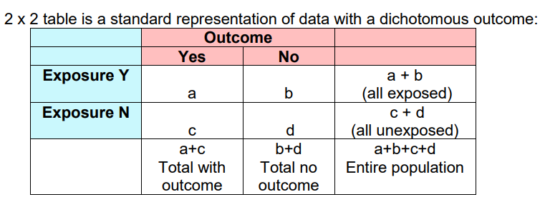
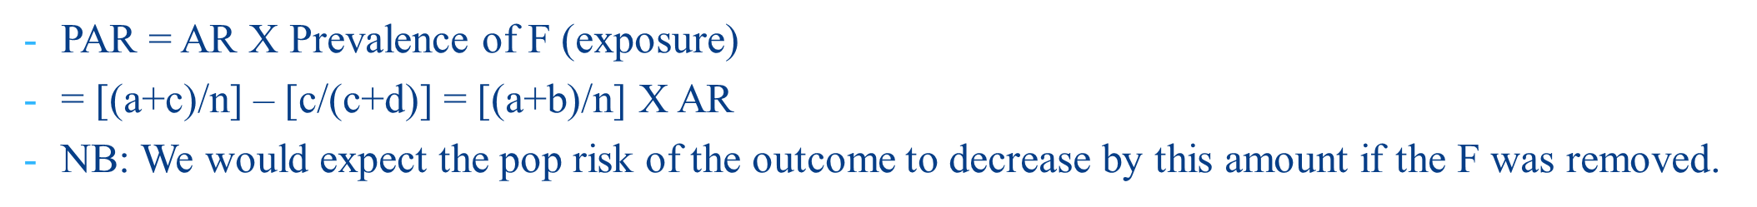
27

Slide 28
Disease
Test |  | Positive | Negative
 | Positive | a | b | Total Test positive (a+b)
 | Negative | c | d | Total Test Negative (c+d)
 |  | Total Disease Positive (a+c) | Total Disease Negative (b+d) | Total Population
True prevalence: P(D+) = a+c/n *The proportion of all individuals who are tested who are positive for the outcome of interest.
Apparent prevalence: P(T+) = a+b/n *The proportion of all individuals who are tested who, rightly or wrongly, test positive.
What does a and d represent?
28

Slide 29
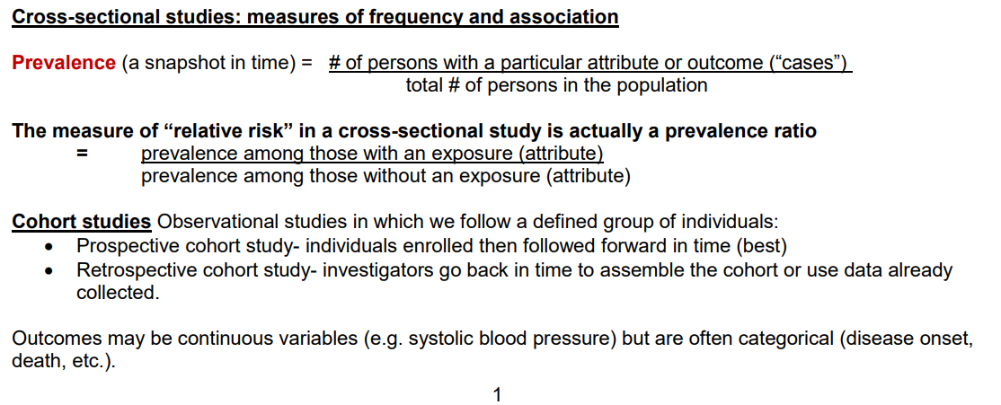
29

Slide 30
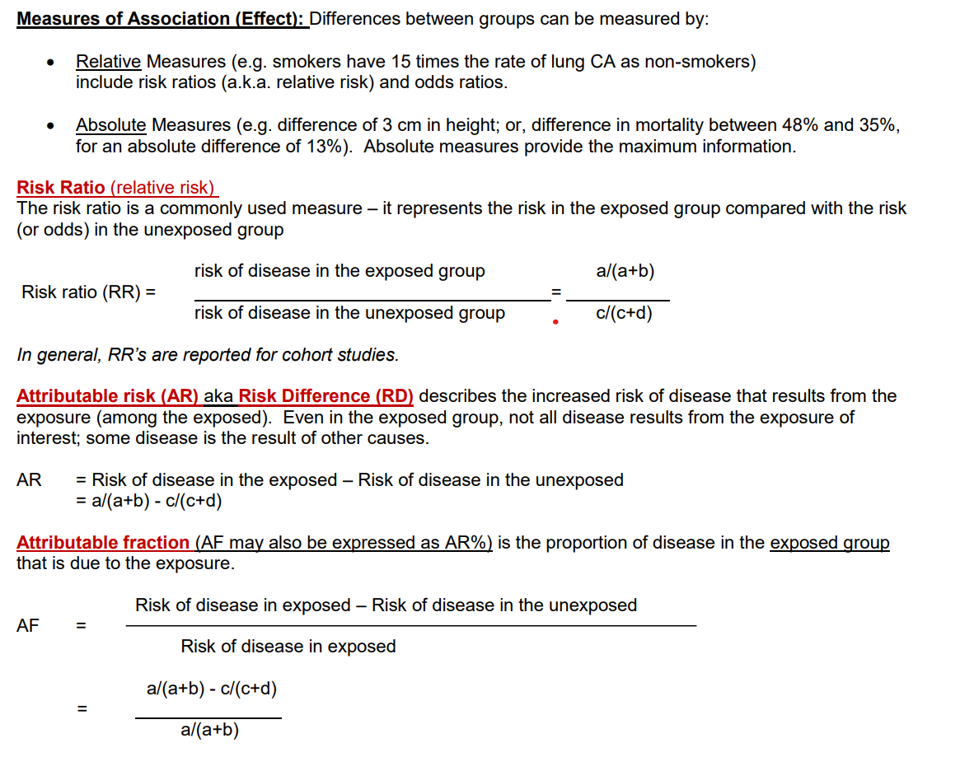
30

Slide 31
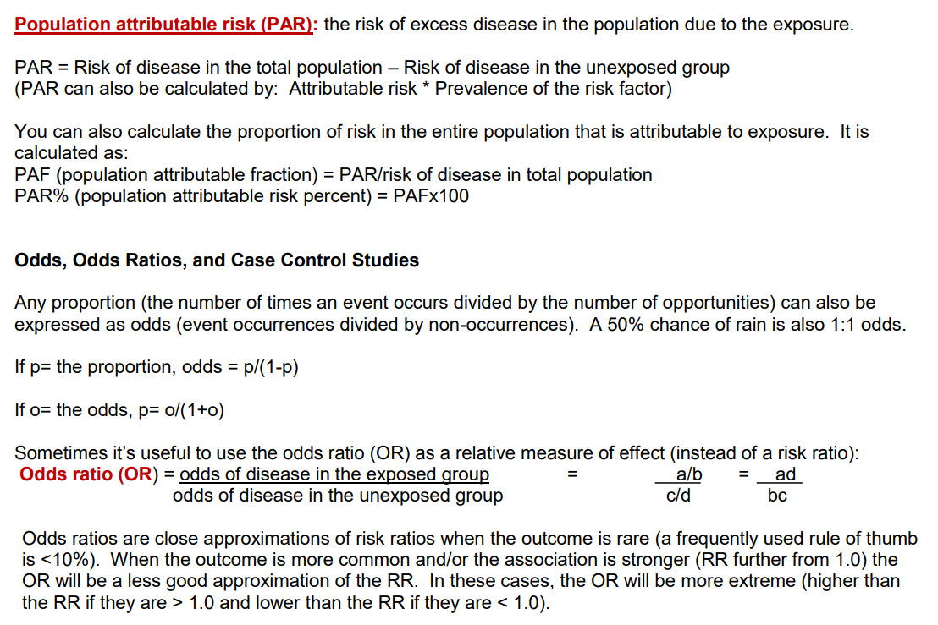
31

Slide 32
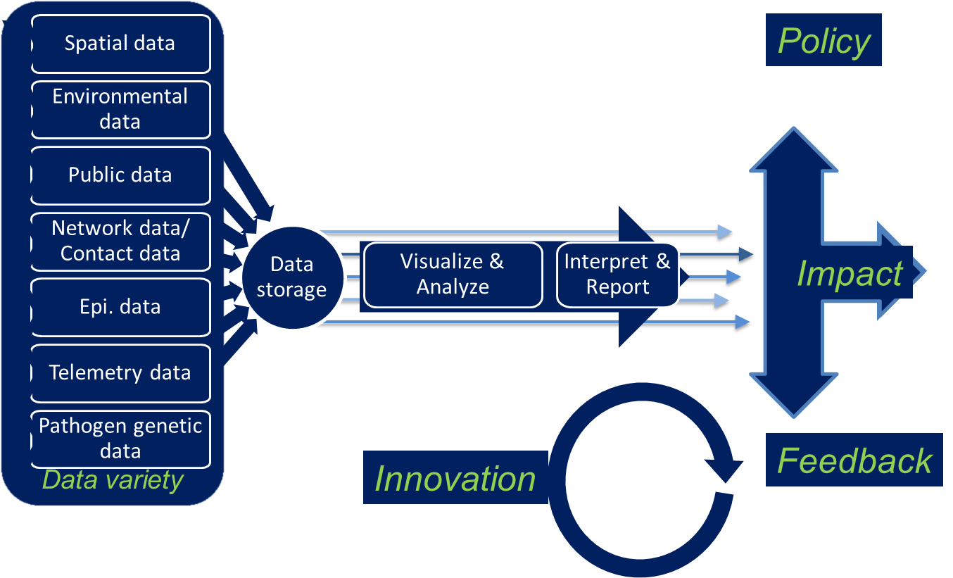
How Do We Translate “Big Data” into “Smart Data for Epidemiology?
32

Slide 33
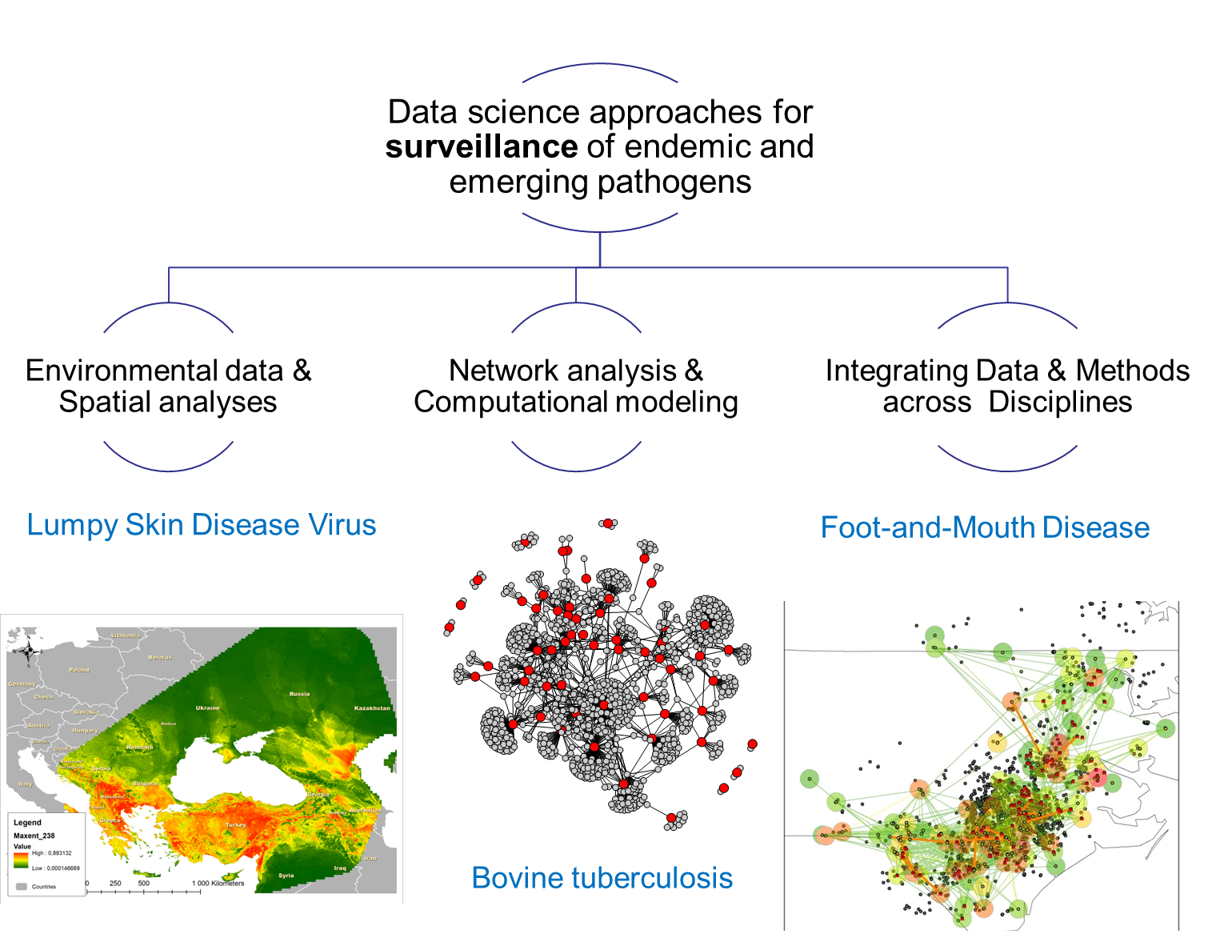
33

